Slide 1

Analysis of Tennis Match Data
An In-Depth Look at Player Performance and Match Statistics
Group 5
July 2024

Slide 2
Introduction
Objective
Data sources
Analyzing tennis match data to uncover patterns and insights related to player performance and match outcomes.
The dataset includes player statistics, match results, and various match-specific metrics from the Parquet file for professional tennis tournaments in May 2024.

Slide 3
Data Overview
Important Data
Relation of Data
Data Cleansing
Data Cleaning
Event
Home/Away Team
Home/Away Score
Statistics
Tournament
Time
Game
“Event” references multiple tables based on “match_id” to gather comprehensive data about the match.
cleaning the data to remove redundant duplicates while keeping necessary unique records.

Slide 4
Data Preparation Challenges
Extract entire files without the risk of data loss.
Extract all the files related to a schema , concat them together, save them in a new Parquet file and use it as a dataframe.
Invalid data (related to winner code of event schema)
Existence of duplicate records based on match_id and non-duplicate in other fields.

Slide 5
Removed duplicates records.
Add a date column to all datasets, sort data by date field, use the latest data, and ignore other records.
Implement methods to extract valid result.
Solution

Slide 6
Analysis Result

Slide 7
1. Number of unique tennis players : 2,352
2. Average height of the players : 1.82
13. Distribution of left-handed versus right-handed players
10. Correlation between a player's height and their ranking
Player Analysis
S : Home/Away team
drop_duplicates(keep='last')
dropna()

Slide 8
3. Player with the highest number of win: Sun Fajing with 15 wins.
Player Analysis
Event (winner_code) ✘
S : Method based on pbp ✔
O : Winners

Slide 9
9. Player with the highest number of tournament wins : Uchijima Moyuka
with 15 wins.
14. The most common tournament surface is red clay.
Player Analysis
S : Winners
S : Tournament
drop_duplicates(keep='last')

Slide 10
16. Player with the highest winning percentage against top 10 ranked opponents : Grigor Dimitrov.
Player Analysis
S : Winners
S : Home/Away team

Slide 11
4. The match with the longest duration lasting 47.54 hours.
5. The typical number of sets is 2.
11. The average duration of matches is 124.25 minutes.
Match Analysis
S : time
drop_duplicates(keep='last')
skipna=True
mode

Slide 12
7. The average number of aces per match is 4.07.
8. The average double fault based on gender
17. The average number of breaks of serve per match is 7.29.
Match Analysis
S : statistics
S : Home/Away team
drop_duplicates(keep='last')

Slide 13
12. The average number of game per set based on gender
Match Analysis
S : pbp
S : Home/Away team
drop_duplicates(keep='last')

Slide 14
15. Number of unique countries in dataset is 99.
6. Country with most successful tennis players
Country Analysis
S : Home/Away team
S : winners
drop_duplicates()
Count the number of wins for each country
Find top 100 ranked players with their country

Slide 15
Additional Findings

Slide 16
Only one Iranian player : Moghimi, Sina has participated in this competition in May 2024.
He has won 3 of the 6 matches he has participated in.
Players have a career spanning more than 15 years.
Distribution of players' weights
Statistics related to players
S : Home/Away team
S : Winners
drop_duplicates(keep='last')
dropna()

Slide 17
5. Tournament with the highest number of participating players is French Open, Paris, France with 130 players.
Statistics related to tournament
S : Tournament
drop_duplicates(keep='last')

Slide 18
6. The number of matches decided by a tie-break is: 1413
7. Average number of games per match
8. Player with the most double faults in a single match is Braynin, Aleksandr with 48 fault.
9. Cities which hosted the most tennis matches
Statistics related to matches
S : pbp
S : Statistics
S : Home/Away team score
drop_duplicates(keep='last')
dropna()

Slide 19
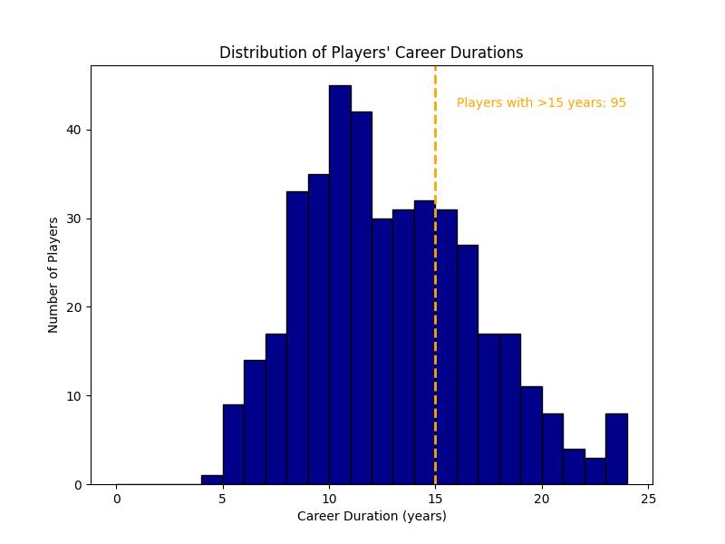
Distribution of players' career durations

Slide 20
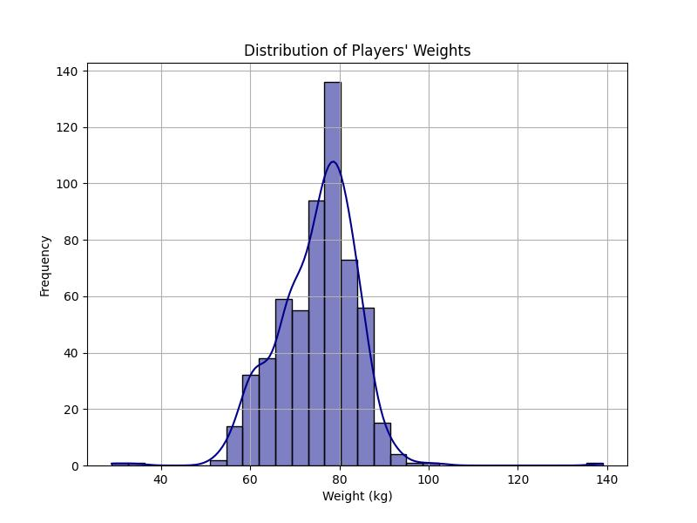
Distribution of players' weights in the dataset

Slide 21
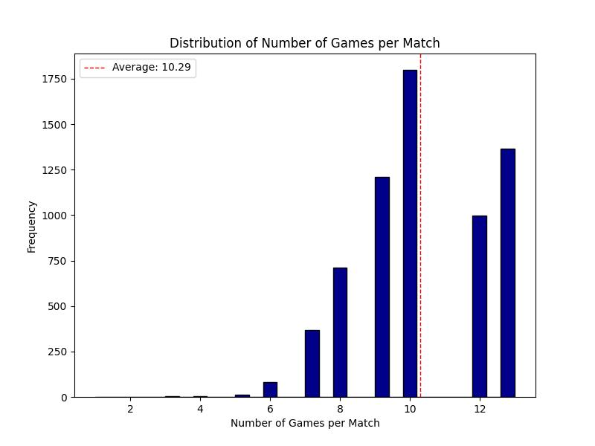
Average number of games per match

Slide 22
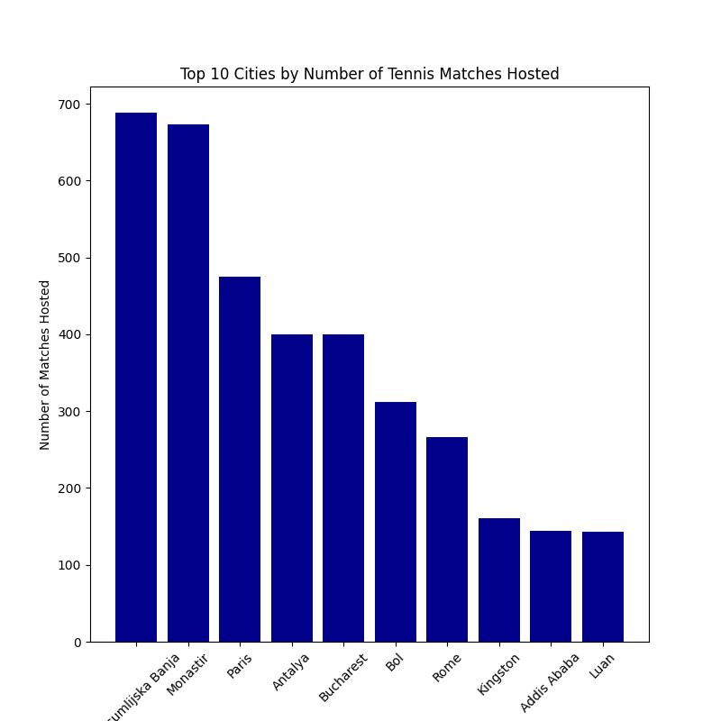
Cities which hosted the most tennis matches

Slide 23
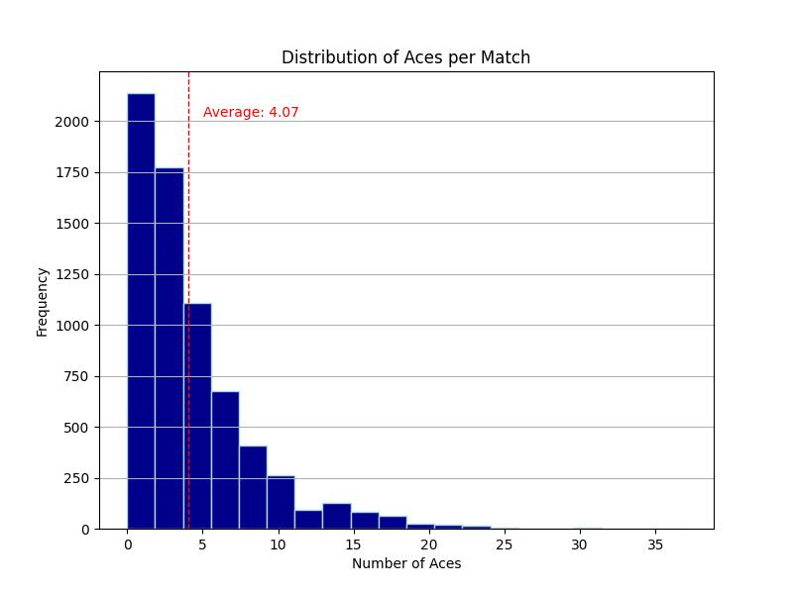
Average number of aces per match is 4.07

Slide 24
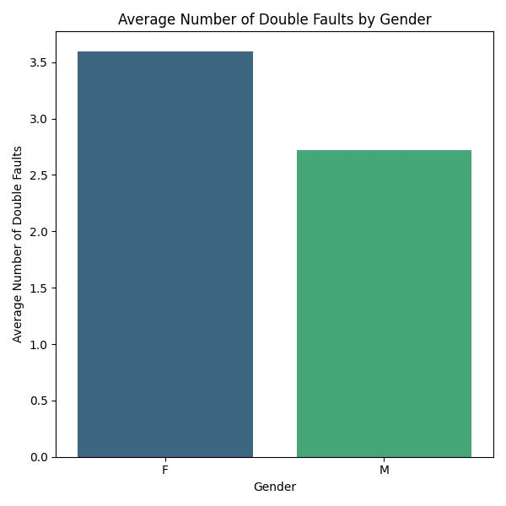
The average number of double faults for females is 3.58 and for males is 2.71.

Slide 25
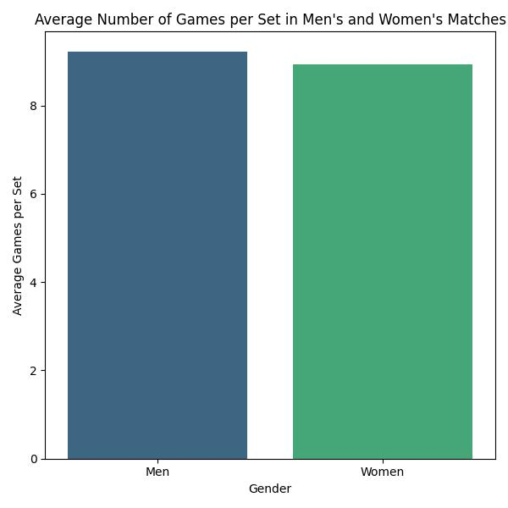
The average number of games per set in men's matches is 9.22.
The average number of games per set in women's matches is 8.93.

Slide 26
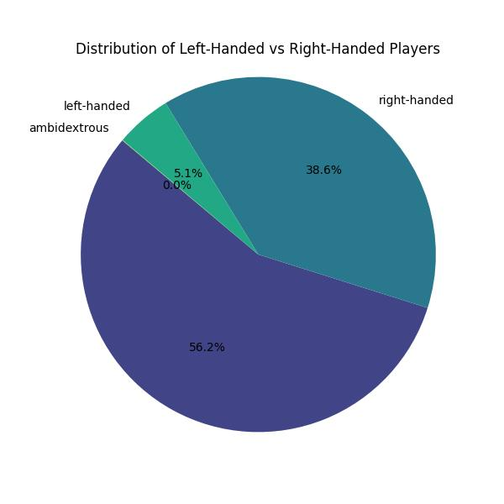
Distribution of left-handed versus right-handed players

Slide 27
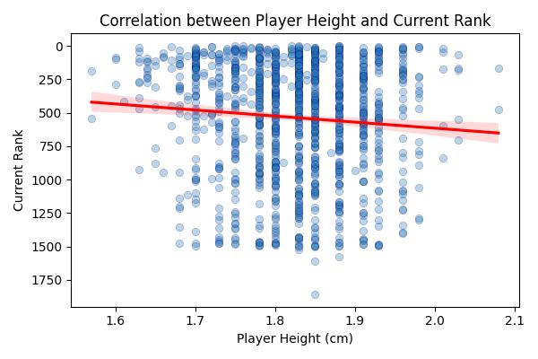
Correlation between a player's height and their ranking

Slide 28
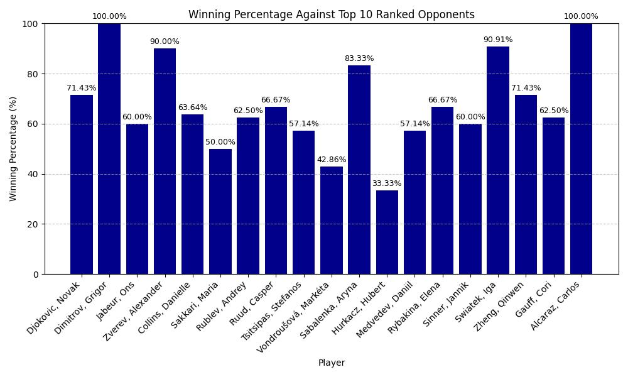
Which player has the highest winning percentage against top 10 ranked opponents?

Slide 29
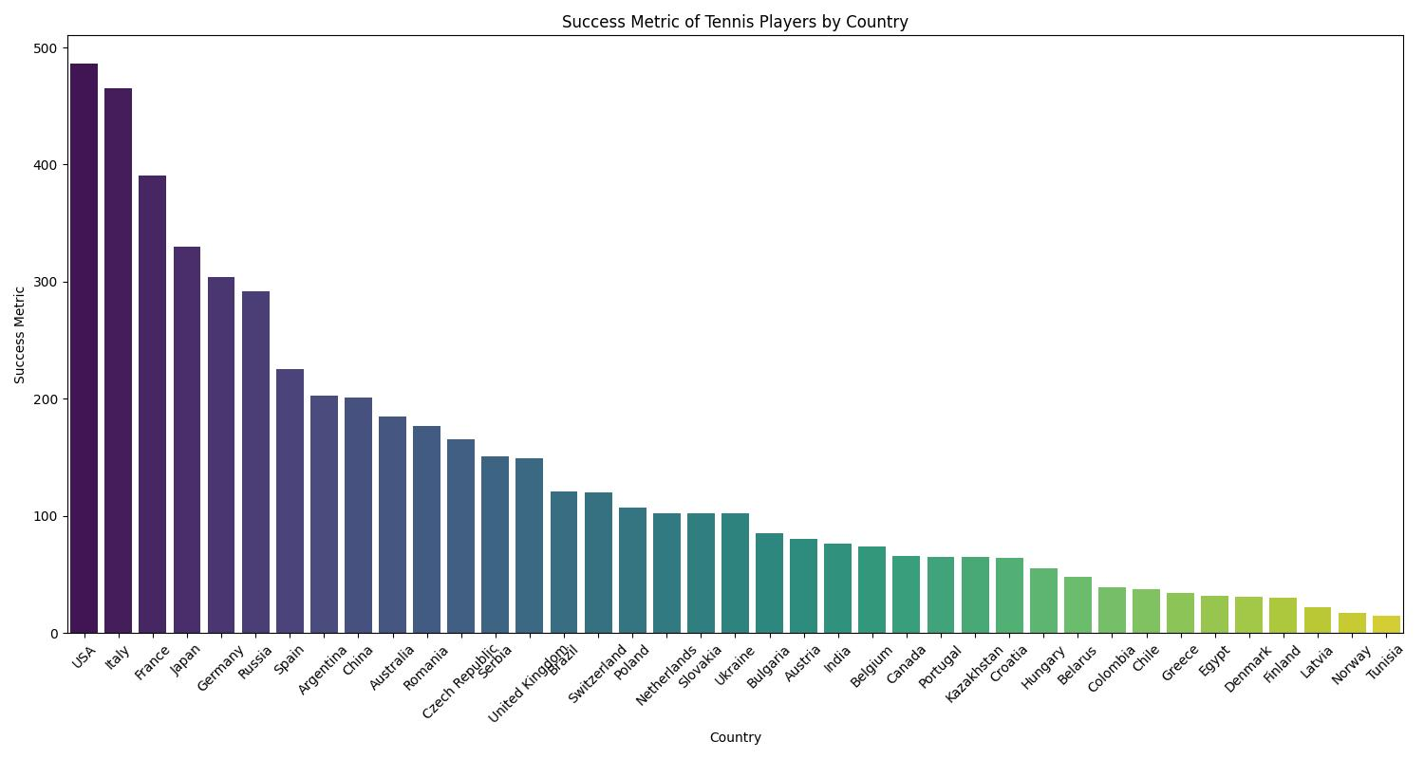
Data set includes 99 unique countries and the USA is The country with the most successful tennis players with a success metric of 516 (462 wins in May 2024 and 24 top 100 players).

Slide 30

Thanks for your attention

